Slide 1
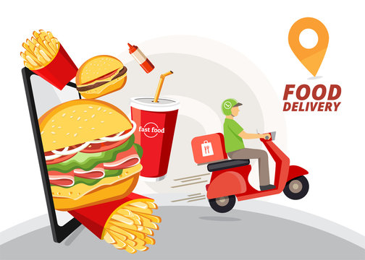
Food Delivery Performance Analysis
Power BI Dashboard
Food Delivery Dataset
Late Delivery Analysis
Business & Research Analysis
Prepared by : Hina Irshad

Slide 2

Introduction
Analysis of food delivery orders
Focus on late deliveries
Study of traffic, weather, distance & restaurants
Dashboard created using Power BI
Dataset: Food Delivery Orders
Orders: 50,000+ records
Data Source: Kaggle
Contains customer, restaurant, driver & delivery data
Important Columns
City | Traffic | Weather | Distance | Delivery Time | Late Delivery

Slide 3
Business Questions???
Which city has more delivery problems?
Does traffic increase delays?
Does weather affect delivery?
Does distance affect delivery time?
How can late deliveries be reduced?

Slide 4
Research Questions
RQ1: What factors cause late deliveries?
RQ2: How do traffic and weather affect delivery?
RQ3: Does distance increase delivery time?
RQ4: Does restaurant preparation time affect delays?
RQ5: Does driver experience affect delivery performance?

Slide 5
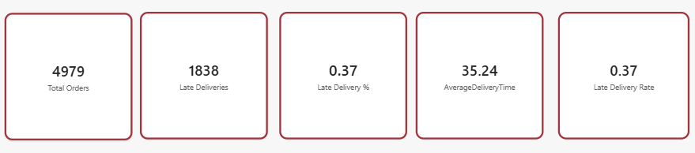
KPI Cards
KPI Card | Value
Total Orders | 4,979
Late Deliveries | 1,838
Late Delivery % | 37%
Average Delivery Time | 35.24 min

Slide 6
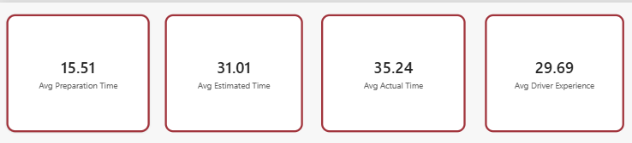
Delivery Performance Overview
KPI Cards:
Avg Preparation Time → 15.51 min
Avg Estimated Time → 31.01 min
Avg Actual Time → 35.24 min
Avg Driver Experience → 29.69 months
Highlight:
Actual delivery time is higher than estimated time.

Slide 7
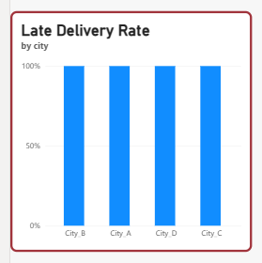
Late Delivery Rate by City
Key Highlight:
Compare late delivery performance across cities.
Identify cities requiring operational improvement.

Slide 8
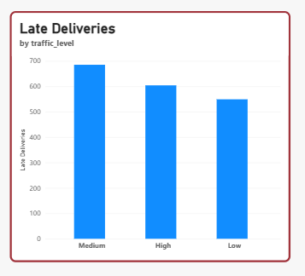
Impact of Traffic on Late Deliveries
Highlight:
Medium traffic shows the highest late deliveries.
Traffic management can improve delivery performance.

Slide 9
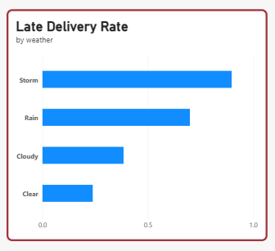
Impact of Weather
Highlight:
Storm has the highest late delivery rate.
Rain also increases delivery problems.

Slide 10
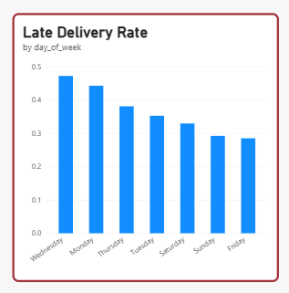
Late Delivery Rate by Day
Highlight:
Wednesday has the highest rate.
Delivery performance changes by day.

Slide 11
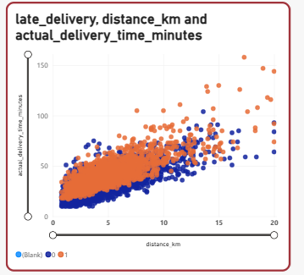
Distance vs Actual Delivery Time
Distance (km) → Actual Delivery Time (minutes)
Key Highlight:
Longer distances generally require more delivery time.
Distance is an important factor in delivery performance.

Slide 12
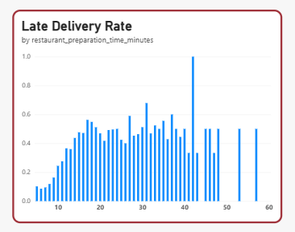
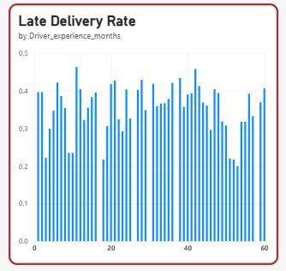
Restaurant & Driver Factors
Late Delivery Rate by Restaurant Preparation Time
Late Delivery Rate by Driver Experience
Key Points:
Restaurant preparation affects total delivery time.
Driver experience can influence delivery efficiency

Slide 13
Key Findings & Recommendations
Key Findings :
37% late delivery rate
Traffic affects delivery performance
Storm and rain create more delays
Longer distance increases delivery time
Actual time > estimated time
Recommendations :
Improve delivery time estimation
Use traffic-aware route planning
Prepare for bad weather
Reduce restaurant preparation time
Improve driver allocation

Slide 14
Conclusion
Recommendations
Traffic and bad weather affect delivery performance.
Longer distance can increase delivery time.
Restaurant preparation time is also important.
Actual delivery time (35.24 min) is higher than estimated time (31.01 min).
Improve delivery time estimation.
Use traffic-aware routes.
Prepare better for bad weather.
Improve restaurant preparation speed.
Final Message:
Data-driven decisions can reduce late deliveries and improve customer satisfaction.

Slide 15
Thank you

